Slide 1
P-1 : INTENSITY TRANSFORMATIONS AND SPATIAL FILTERING

Slide 2
An image kernel is a small matrix used to apply effects like the ones you might find in Photoshop or Gimp, such as blurring, sharpening, outlining or embossing. They're also used in machine learning for 'feature extraction', a technique for determining the most important portions of an image.

Slide 3
Spatial domain refers to the image plane itself, and image processing methods in this category are based on direct manipulation of pixels in an image.
Two principal categories of spatial processing are intensity transformations and spatial filtering.
Intensity transformations operate on single pixels of an image for the purpose of contrast manipulation and image thresholding.
Spatial filtering deals with performing operations, such as image sharpening, by working in a neighbourhood of every pixel in an image.
Generally, spatial domain techniques are more efficient computationally and require less processing resources to implement.
The spatial domain processes can be denoted by the expression :
g(x, y) = T [ f( x, y ) ]
where f(x, y) is the input image, g(x, y) is the output image, and T is an operator on f defined over a neighbourhood of point (x, y). The operator can apply to a single image or to a set of images.

Slide 4
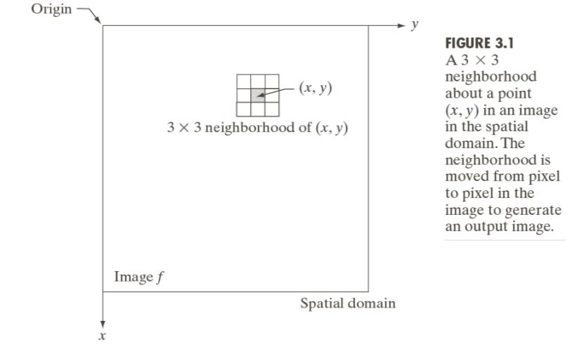
Typically, the neighbourhood is rectangular, centered on (x, y), and much smaller than the image.
The smallest possible neighbourhood is of size 1×1. In this case, g depends only on the value of f at a single point (x, y) and T in the above equation becomes intensity(also called a gray-level or mapping) transformation function of the form:
s = T(r)
Where, for simplicity in notation, we use s and r to denote, respectively, the intensity of g and f at any point (x, y)

Slide 5
Basic gray-level transformations
Image Negatives
Flipping and Flopping
Log Transformations
Power law or Gamma Transformations
Piecewise Linear Transformation Functions

Slide 6
Basics of Spatial Filtering
The name ‘filter’ is borrowed from frequency domain processing where filtering refers to passing, modifying and rejecting specified frequency components of an image.
For eg. A filter that passes low frequencies is called low pass filter

Slide 7
P-2 : FILTERING IN THE FREQUENCY DOMAIN
Some basic concepts :
e^{ix} = cos x + i sin x (Euler’s Formula)
Periodicity = Repetition over an interval
Periodicity arises from symmetry
Sum of 2 periodic functions is not always periodic.

Slide 8
FOURIER TRANSFORMATION
The Fourier transform is a tool that breaks down a waveform (which is a function or a signal) into alternate representations characterized by sines and cosines.
ONE OF THE FUNDAMENTAL SECRETS OF UNIVERSE : All waveforms, no matter what you scribble or observe in the universe, are actually just the sum of simple sinusoids of different frequencies.
Basically there are quite a few domains like Spatial, Frequency, Time and Temporal,etc. While studying Fourier transformation, we are mostly concerned about conversion of Spatial Domain to Frequency Domain and vice-versa.

Slide 9
There are 2 aspects of Fourier Study:
Analysis (Breaking down into simpler constituent parts) and
Synthesis (Reassemble a signal from it’s constituent parts)
Fourier Analysis is often related with problems of symmetry.
But the question arises that how can we use such simple functions i.e Sines and Cosines to model such complex periodic phenomena?
Not all phenomena are periodic, even phenomena that are periodic in time, die out eventually.
But periodic functions like Sines and Cosines go on forever, so how can they be used to model such ‘dying out’ phenomena?
We can still apply ideas of periodicity by ‘forcing’ the periodicity infinite times. Just repeat the pattern. This is known as Periodization of a signal.

Slide 10
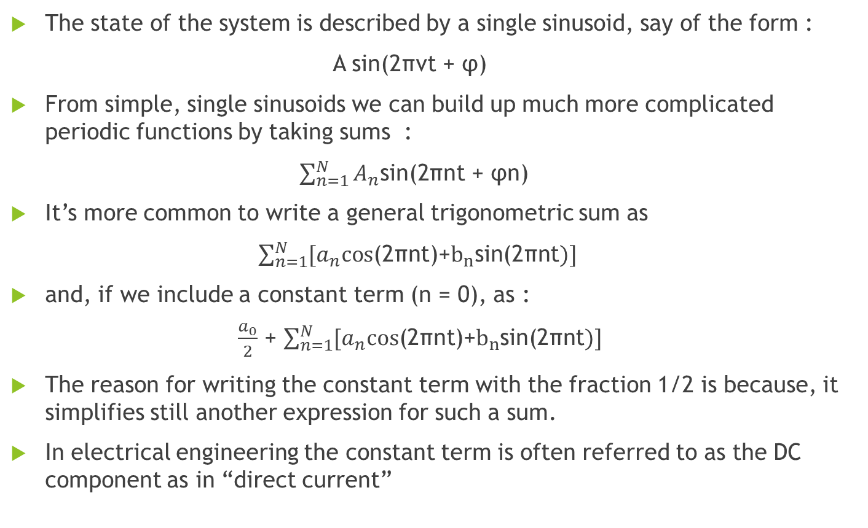
The state of the system is described by a single sinusoid, say of the form :
A sin(2πνt + φ)
From simple, single sinusoids we can build up much more complicated periodic functions by taking sums :
$\sum_{n=1}^{N}{A_{n}\text{sin}\text{(2}\text{πnt}\text{ + }\text{φn}\text{) }}$
It’s more common to write a general trigonometric sum as
$\sum_{n=1}^{N}{[a_{n}\text{cos}\text{(2}\text{πnt}\text{)}\text{+}b_{n}\text{sin}\text{(2}\text{πnt})]}$
and, if we include a constant term (n = 0), as :
$\frac{a_{0}}{2}$ + $\sum_{n=1}^{N}{[a_{n}\text{cos}\text{(2}\text{πnt}\text{)}\text{+}b_{n}\text{sin}\text{(2}\text{πnt})]}$
The reason for writing the constant term with the fraction 1/2 is because, it simplifies still another expression for such a sum.
In electrical engineering the constant term is often referred to as the DC component as in “direct current”

Slide 11

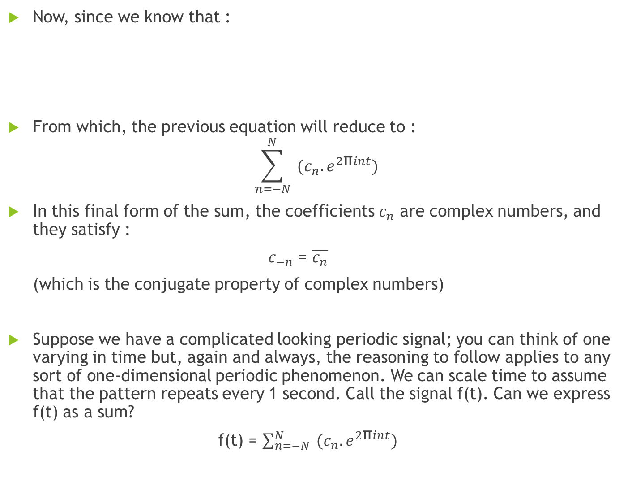
Now, since we know that :
From which, the previous equation will reduce to :
$$\sum_{n=−N}^{N}{{ (c_{n}.e}^{2\text{π}int})}$$
In this final form of the sum, the coefficients $c_{n}$ are complex numbers, and they satisfy :
$c_{−n}$ = $\overline{c_{n}}$
(which is the conjugate property of complex numbers)
Suppose we have a complicated looking periodic signal; you can think of one varying in time but, again and always, the reasoning to follow applies to any sort of one-dimensional periodic phenomenon. We can scale time to assume that the pattern repeats every 1 second. Call the signal f(t). Can we express f(t) as a sum?
f(t) = $\sum_{n=−N}^{N}{{ (c_{n}.e}^{2\text{π}int})}$

Slide 12
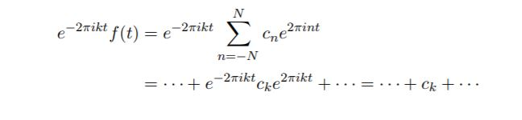

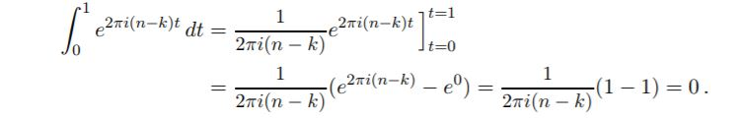
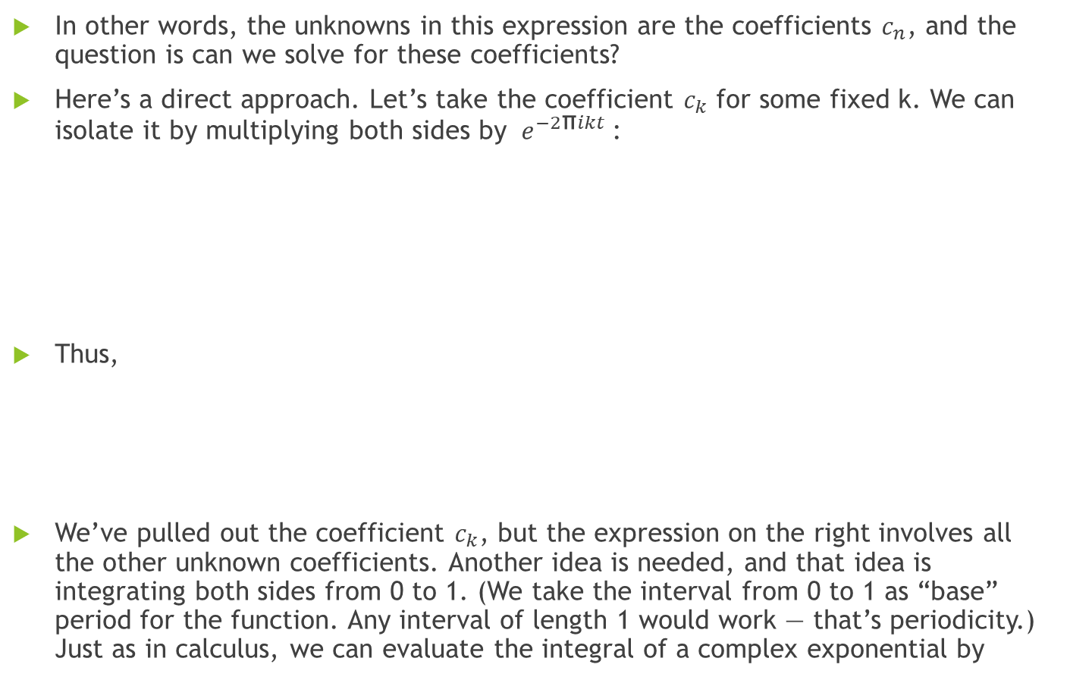
In other words, the unknowns in this expression are the coefficients $c_{n}$, and the question is can we solve for these coefficients?
Here’s a direct approach. Let’s take the coefficient $c_{k}$ for some fixed k. We can isolate it by multiplying both sides by ${ e}^{−2\text{π}ikt}$:
Thus,
We’ve pulled out the coefficient $c_{k}$, but the expression on the right involves all the other unknown coefficients. Another idea is needed, and that idea is integrating both sides from 0 to 1. (We take the interval from 0 to 1 as “base” period for the function. Any interval of length 1 would work — that’s periodicity.) Just as in calculus, we can evaluate the integral of a complex exponential by

Slide 13
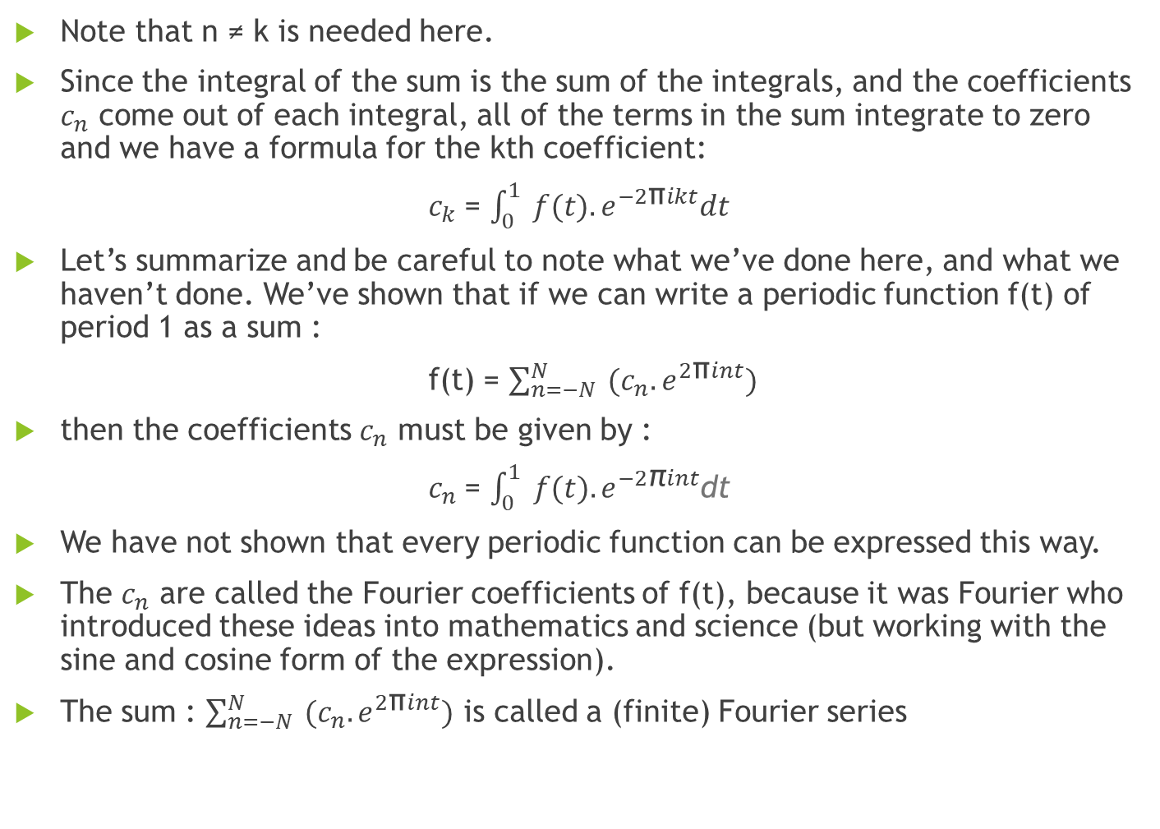
Note that n ≠ k is needed here.
Since the integral of the sum is the sum of the integrals, and the coefficients $c_{n}$ come out of each integral, all of the terms in the sum integrate to zero and we have a formula for the kth coefficient:
$c_{k}$= $\int_{0}^{1}{{ f(t).e}^{−2\text{π}ikt}dt}$
Let’s summarize and be careful to note what we’ve done here, and what we haven’t done. We’ve shown that if we can write a periodic function f(t) of period 1 as a sum :
f(t) = $\sum_{n=−N}^{N}{{ (c_{n}.e}^{2\text{π}int})}$
then the coefficients $c_{n}$ must be given by :
$c_{n}$= $\int_{0}^{1}{{ f(t).e}^{−2\text{π}int}}$dt
We have not shown that every periodic function can be expressed this way.
The $c_{n}$ are called the Fourier coefficients of f(t), because it was Fourier who introduced these ideas into mathematics and science (but working with the sine and cosine form of the expression).
The sum : $\sum_{n=−N}^{N}{{ (c_{n}.e}^{2\text{π}int})}$ is called a (finite) Fourier series

Slide 14
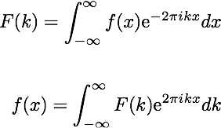
So, in general;
The First one is the original Fourier Transform equation and the second one is inverse Fourier transform equation.
How is it used in filtering IN FREQUENCY DOMAIN?

Slide 15
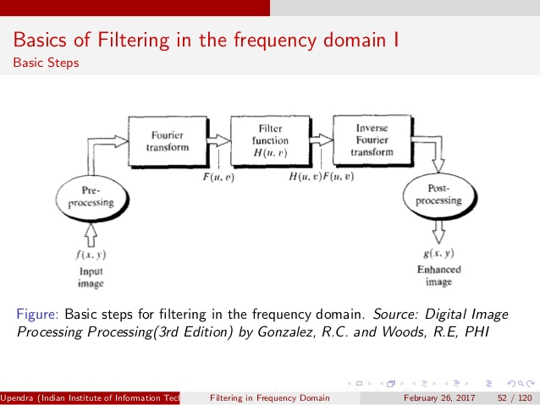

Slide 16

P-3 : WAVELET TRANSFORM
The wavelet transform is similar to the Fourier transform (or much more to the windowed Fourier transform) with a completely different analyzing function. The main difference is this: Fourier transform decomposes the signal into sines and cosines, i.e. the functions localized in Fourier space; in contrary the wavelet transform uses functions that are localized in both the real and Fourier space. Generally, the wavelet transform can be expressed by the following equation:
where the * is the complex conjugate symbol and function ψ is some function. This function can be chosen arbitrarily provided that it obeys certain rules.

